Slide 1

Characterizing geographic areas using natural language processing
By Luis Eduardo Ferro Diez
Presented in partial fulfillment to obtain the Title of Magister in Informatics and Telecommunications - Universidad Icesi - July 14, 2020
Notes:
Saludo, presentación, programa, nombre de mis tutores, nombre del proyecto y qué es (Un enfoque analítico para caracterizar zonas geográficas con contenido de lenguaje natural generado por usuarios en internet)
Cambiar encabezado a blanco.

Slide 2

Agenda
Project Context
Research Problem
Methodology
Related Work
Contribution Overview
Training & Validation
Demo
Conclusions
Notes:
Agregar Agenda de la presentación
Intro a la información contextual para mejorar los resultados en analítica.
El auge de las LBSN ha permitido investigar nuevos caminos.
La comunidad investigadora muestra interés en el contexto de ubicación

Slide 3
Project Context
Notes:
Agregar slide de las preguntas de investigación. ---> mostrar luego que se responden las preguntas

Slide 4
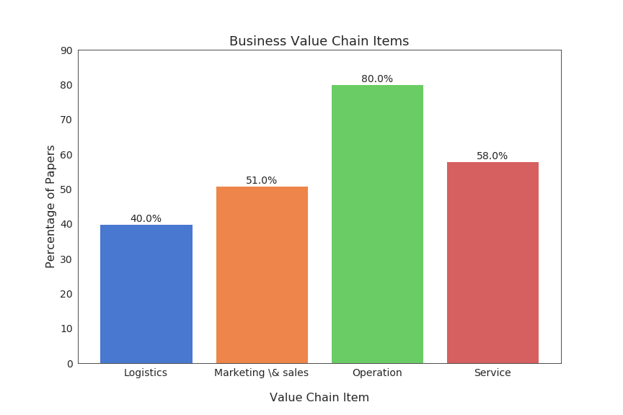
Project Context
Business value chain, Porter 1985.
Context Information in Data analysis.
Location context (LC).
LC in the business value chain
Location context in the business value chain
Notes:
Diferenciar contexto de la tesis del contexto de ubicación etc
Intro a la información contextual para mejorar los resultados en analítica.
El auge de las LBSN ha permitido investigar nuevos caminos.
La comunidad investigadora muestra interés en el contexto de ubicación

Slide 5
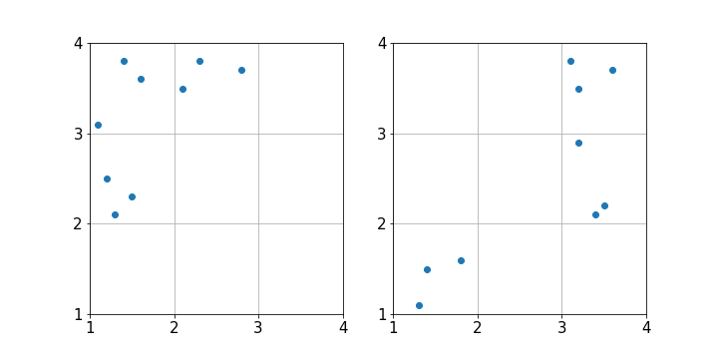
Project Context
Location Aware Advertising (LAA).
Spatial relationships can reveal additional insight.
Options to geographically segment the market.
Notes:
La relación espacial de los elementos es importante.
El concepto de publicidad consciente de la ubicación.
Soluciones para ayudar a la segmentación geográfica del mercado.

Slide 6
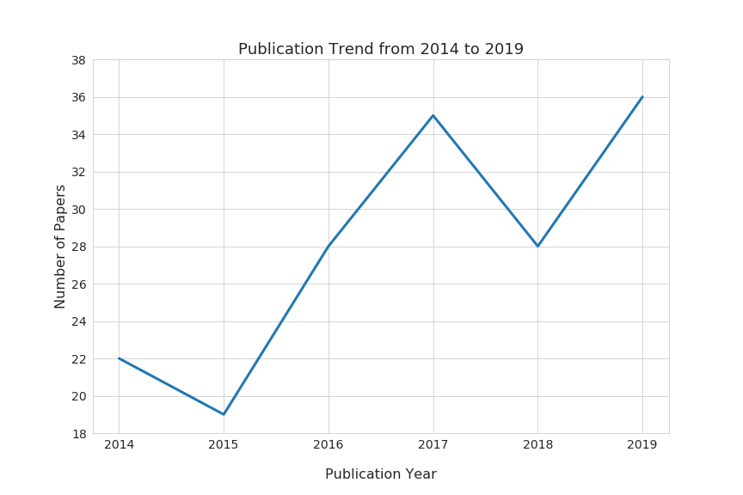
Project Context
Availability of geotagged user data (LBSN).
Increasing interest in exploiting location context.
Notes:
Intro a la información contextual para mejorar los resultados en analítica.
El auge de las LBSN ha permitido investigar nuevos caminos.
La comunidad investigadora muestra interés en el contexto de ubicación

Slide 7
2. Research problem
Notes:
Agregar slide de las preguntas de investigación. ---> mostrar luego que se responden las preguntas

Slide 8
Given a geotagged message data set, and a knowledge corpus about product categories:
How to detect and characterize geographical areas exploiting natural language properties?
Notes:
Recolectando mensajes geolocalizados, cómo segmentar y caracterizar espacios geográficos.

Slide 9
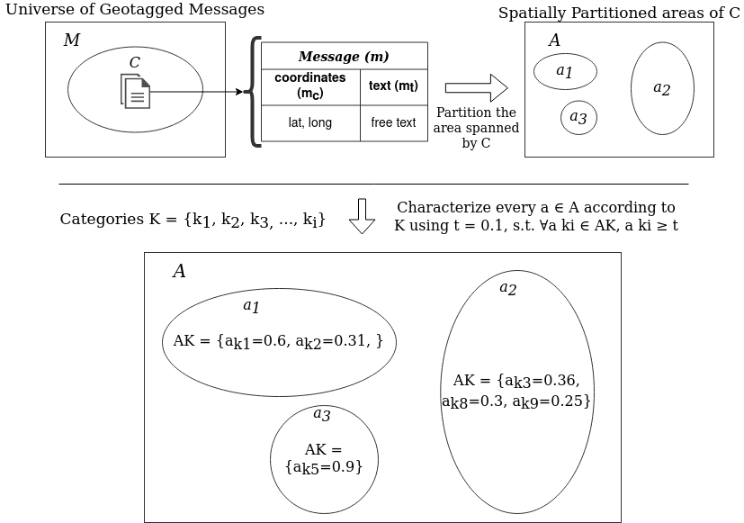
Problem definition
Notes:
Partiendo de un universo de mensajes geolocalizados.
Donde cada mensaje tiene el texto y las coordenadas lat,long.
Cómo particionar el espacio geográfico y
Luego caracterizarlo según un corpus pre-entrenado de categorías de producto.
Intro a la solución con dos componentes.

Slide 10
3. Methodology

Slide 11
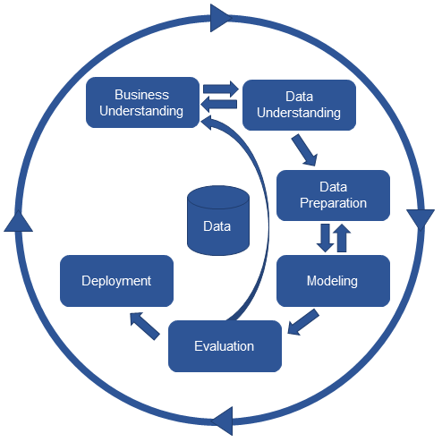
Methodology
A CRISP-DM like process:
SLR
Data Collection
Analyze, understand the data.
Data Pre-Processing
Model training.
Implement a tool to automate some steps.
Obtain the results
Source: https://www.kdnuggets.com/2017/01/four-problems-crisp-dm-fix.html
Notes:
Brevemente la metodología utilizada

Slide 12
4. Related Work
Notes:
Agregar slide sobre la SLR, lo que se hizo y que se envió al Journal KBS
Fondo de slides en blanco

Slide 13
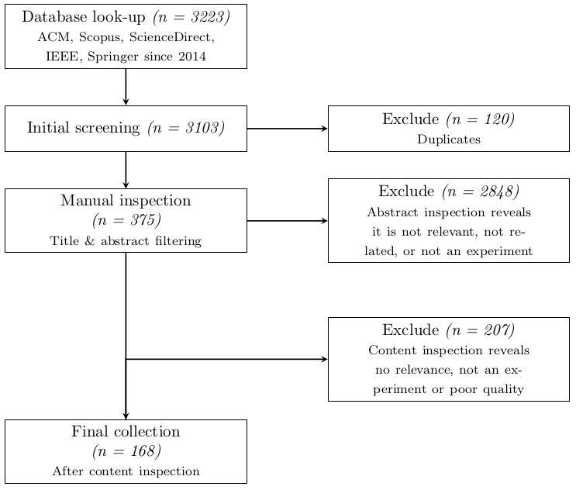
Systematic Literature Review
Kitchenham et al. 2007 guidelines.
Characterization of three main dimensions:
Business
Data
Analytics
Identification of industry domains, value chain processes, data sources, and analytics techniques.
Notes:
Agregar Agenda de la presentación
Intro a la información contextual para mejorar los resultados en analítica.
El auge de las LBSN ha permitido investigar nuevos caminos.
La comunidad investigadora muestra interés en el contexto de ubicación

Slide 14
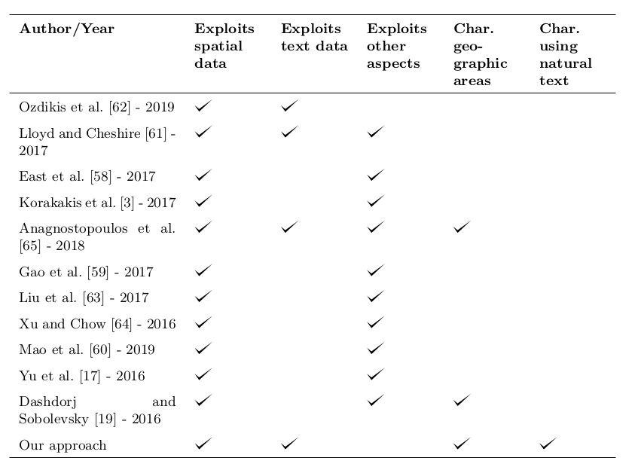
Related Work
Notes:
Partiendo de un universo de mensajes geolocalizados.
Donde cada mensaje tiene el texto y las coordenadas lat,long.
Cómo particionar el espacio geográfico y
Luego caracterizarlo según un corpus pre-entrenado de categorías de producto.
Intro a la solución con dos componentes.

Slide 15
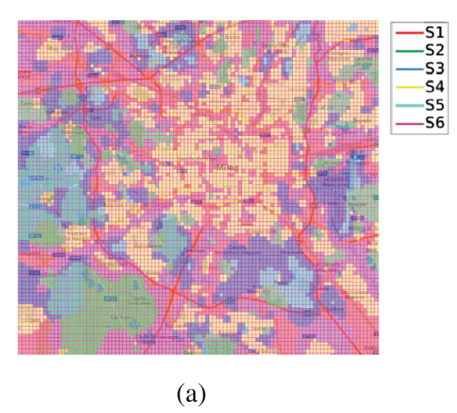
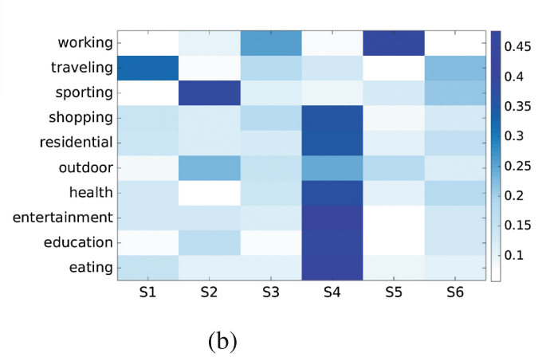
Related Work
Dashdorj et al. 2016
Exploit time context.
No partitioning.
POI centric approach.
Source: Characterization of behavioral patterns exploiting description of geographical areas
, Dashdorj et al. 2016

Slide 16
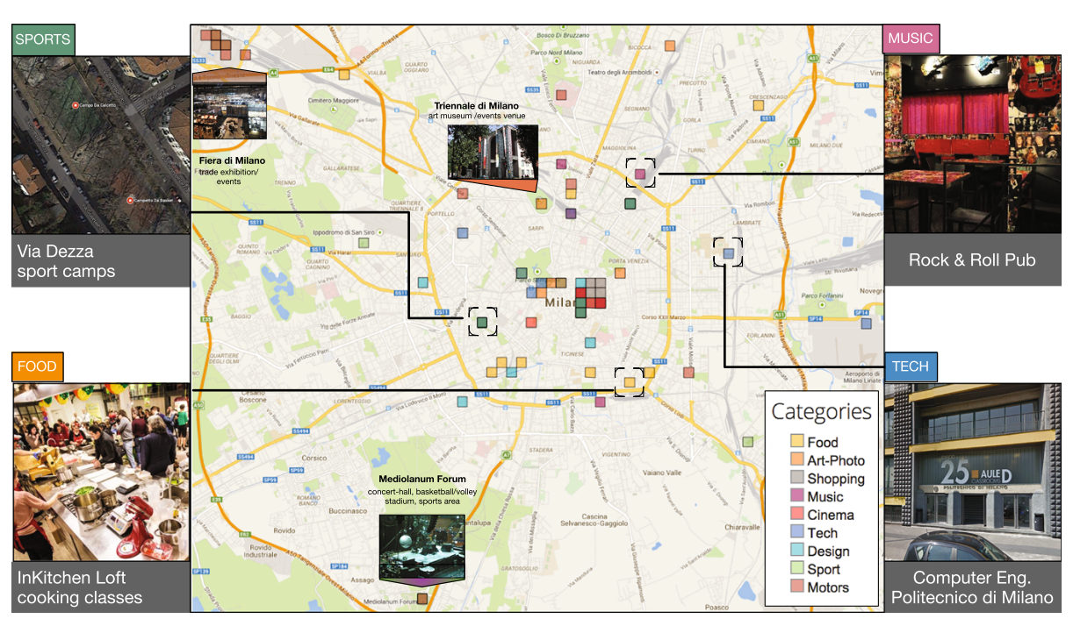
Related Work
Anagnostopoulos et al. 2018
Exploit social context.
Fixed squared shapes geographic partitions.
Depends on “Influencers”
Source: Targeted interest-driven advertising in cities using Twitter, Anagnostopoulos et al. 2018

Slide 17
5. Contribution Overview
Notes:
Agregar slide de las preguntas de investigación. ---> mostrar luego que se responden las preguntas

Slide 18
Contribution Overview
Product Corpus
Product Document Classifier
P1: Music, Movies
P2: Clothing, Sports
P3: Healthcare, Kitchen
Geotagged opinions
Geospatial partitions & classification
Aggregate partition text.
Classify each partition.
Present score and size.
Notes:
Intro a los componentes de la solución. Crear sección de contribuciones con este slide, explicar la solución/approach, explicar los componentes de la solución. Mover acá la explicación de los componentes.

Slide 19
Product Documents Classifier
Notes:
Lo que se espera lograr con el primer componente de la solución.

Slide 20
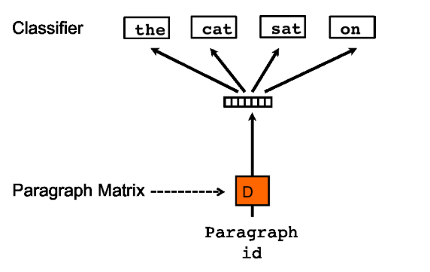
Product Document Embeddings
Conceptual Overview
Trained the embeddings from scratch.
PV-DBOW Algorithm
Text pre-processing:
Use stop words
Lowercase everything
PV-DBOW, Source: Q. Le and T. Mikolov, “Distributed representations of sentences and documents” 2014
Notes:
Intro a PV-DM y PV-DBOW.
Separar las partes de experimento de explicación conceptual

Slide 21
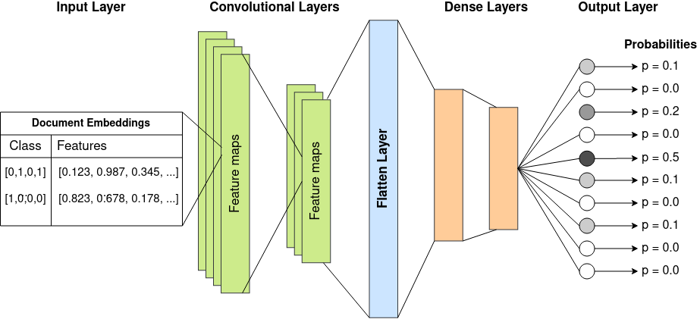
Product Document Classifier
Notes:
Falta ralla que va al 0.2

Slide 22
Partition & classify geographic areas
Notes:
Lo que se espera lograr con el primer componente de la solución.

Slide 23
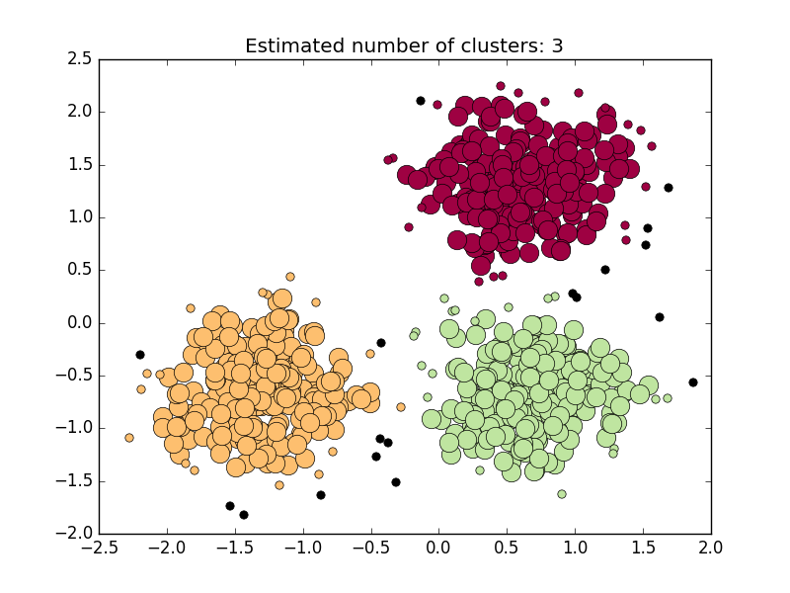
Geospatial clustering & prediction
Density Based Clustering.
Detect and discard noise.
Use OPTICS algorithm, M. Ankerst, M. M. Breunig, H. P. Kriegel, and J. Sander, “OPTICS: Ordering Points to Identify the Clustering Structure” 1999

Slide 24
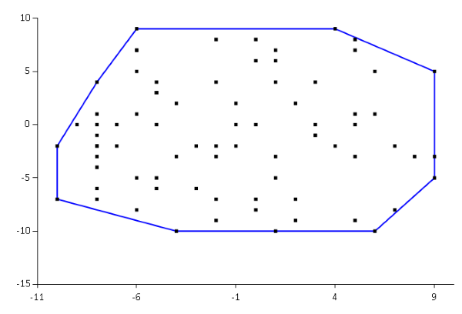
Geospatial clustering & prediction
Cluster polygon calculation.
Convex hulls. S. Kisilevich et al. 2010
Quickhull Algorithm C. B. Barber et al. 1996

Slide 25
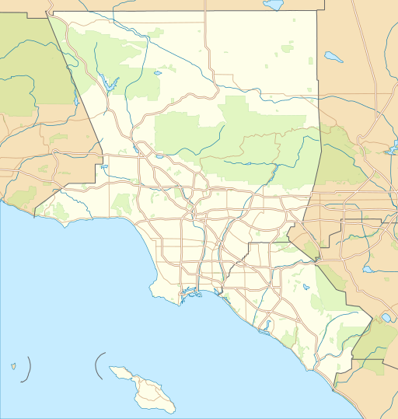
Geospatial clustering & prediction
Cluster corpus aggregation.
Prediction with the document classifier.
Characterization.
Music
Clothes

Slide 26
6. Training & Validation

Slide 27
Data sets
Amazon
Twitter

Slide 28
Amazon Product Reviews
Extracted from
J. McAuley, C. Targett, Q. Shi, and A. Van Den Hengel, “Image-based recommendations on styles and substitutes” 2015
R. He and J. McAuley, “Ups and downs: Modeling the visual evolution of fashion trends with one-class collaborative filtering” 2016
82.83 million reviews
9.4 million product descriptions
Notes:
Intro al data set
Decir que a la final fueron 8

Slide 29
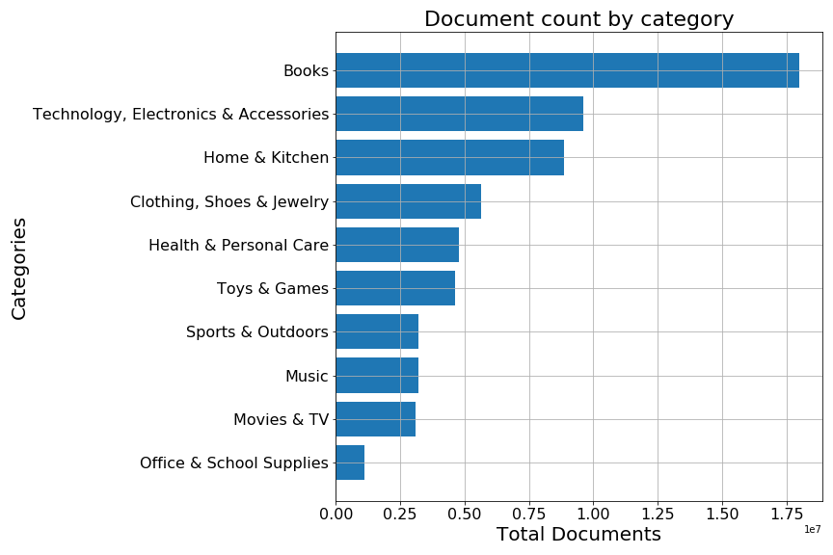

Amazon Product Reviews
Documents from:
Product names and descriptions.
Review summaries and text
59.6 million documents
10 Categories
Baseline: 29.4%: The predominant category, Books
Notes:
Descripción del pre-processing.
Resultados del pre-processing.
Baseline 29.4%

Slide 30
Tweet Stream Grab
Extracted from
J. Scott, “Archive Team: The Twitter Stream Grab,” 2012.
Tweets from June to September 2013
607.7 million tweets (Total)
Notes:
Intro al data set

Slide 31
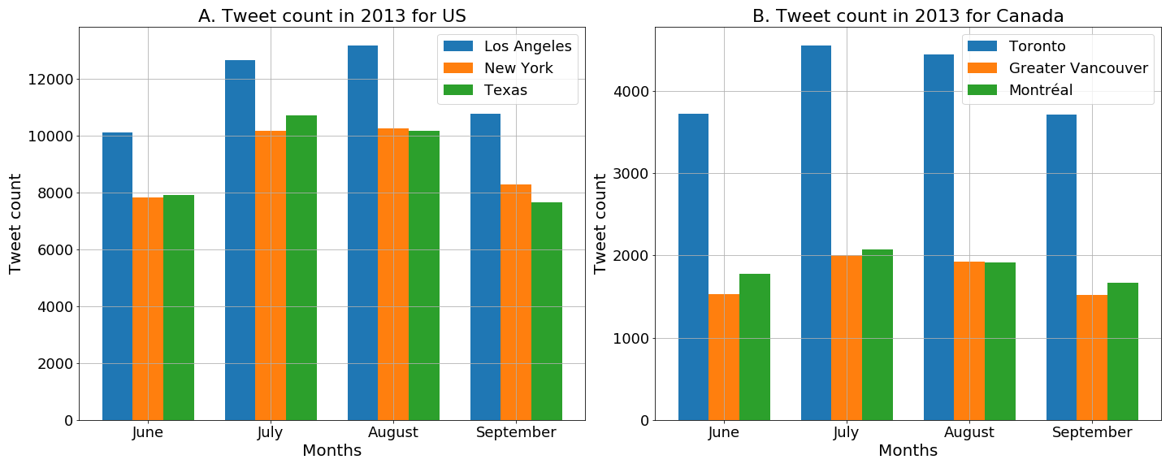
Twitter Stream Grab
9.1 million records, 1.48% of the original data set
Notes:
Descripción del pre-processing: Filtered non-geotagged messages.
Tweet count per city.

Slide 32
Product Document Classifier
Product Document Embeddings
Product Document classifier

Slide 33
Product Document Classifier: Embeddings
A vectorized representation of product documents
Notes:
Lo que se espera lograr con el primer componente de la solución.

Slide 34


Product Document Embeddings
Implementation
Used NLP Python module Gensim.
Used 8 million document corpus.
717.9 million words.
2.6 million of unique words.
300 dimension output.
Notes:
Intro a PV-DM y PV-DBOW.
Separar las partes de experimento de explicación conceptual

Slide 35
Product Document Classifier: ANN
Classify product document vectors
Notes:
Usar solo una entre la negra y la verde

Slide 36


Product Document Classifier
Training
Used Keras and Tensorflow
Baseline: 29%
Hold-out: 70% training, 30% testing. Further split during training: 80% training, 20% validation
For hyperparameter tuning: 1.5 million document vectors
Results: Accuracy of 77% in training, 81% in validation, and 77% in the testing set.
For full training: 8 million document vectors
Results: Same results as in hyperparameter tuning.
70% F1-Score

Slide 37
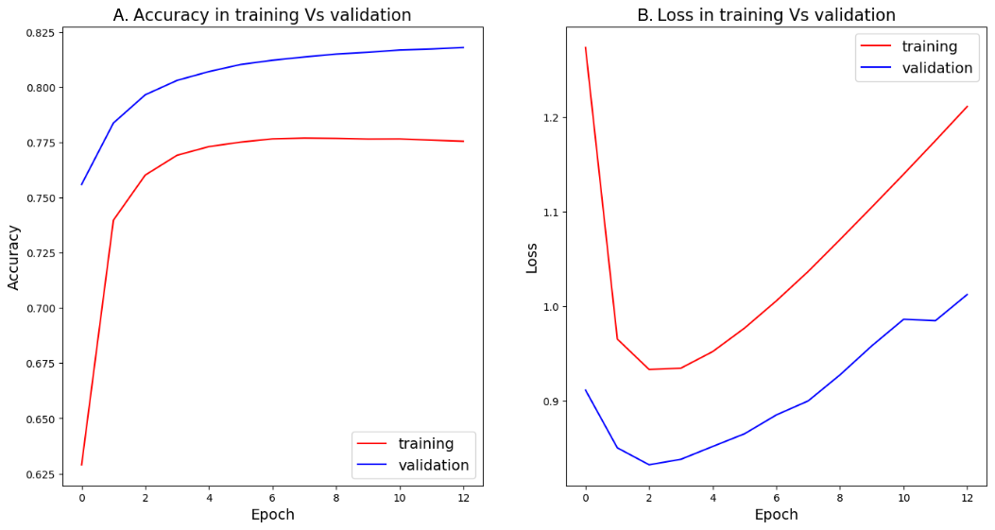
Product Document Embeddings
Full Training

Slide 38
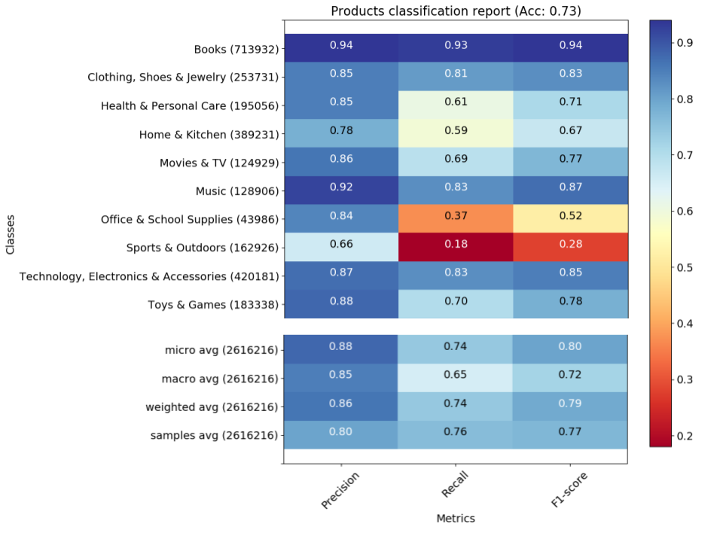
Product Document Embeddings

Slide 39
Product Document Embeddings
Document | True Categories | Predicted Categories
OEM carburetor [sic]. This product was the ex- act fit for the engine that is on my tractor. so far the part performance is flawless no leaks and problems. | Home & Kitchen | Home & Kitchen (0.82)
Disappointed. Plastic is too flimsy. Its not rubber outer core, its slick. Thought it wouldnt slide off tables, counters, dash. It does! | Technology, Elec- tronics & Accessories | Home & Kitchen (0.37); Technology, Electronics & Accessories (0.37); Toys & Games (0.18)
Jim from Ocala, Fl. great replacement product. Has been in use for several months with no prob- lem. This is a very good replacement battery. would order again inthe future. | Home & Kitchen; Technology, Elec- tronics & Accessories | Health & Personal Care (0.10); Home & Kitchen (0.24); Technology, Electronics & Accessories: (0.64)

Slide 40
Geospatial clustering & prediction
Calculation
Aggregation & Prediction

Slide 41
Calculate geospatial clusters

Slide 42

Geospatial clustering calculation
10 minimum neighbors
Variable Ɛ, depending on the city selected.
Create polygons using convex-hull

Slide 43
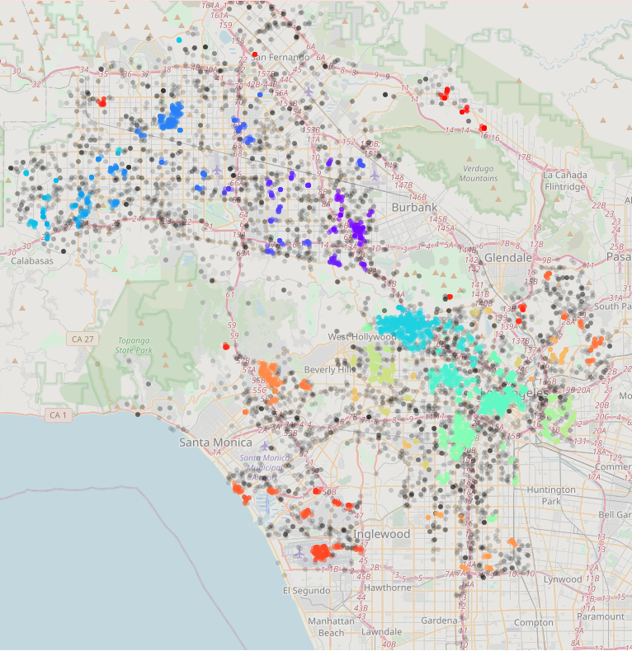
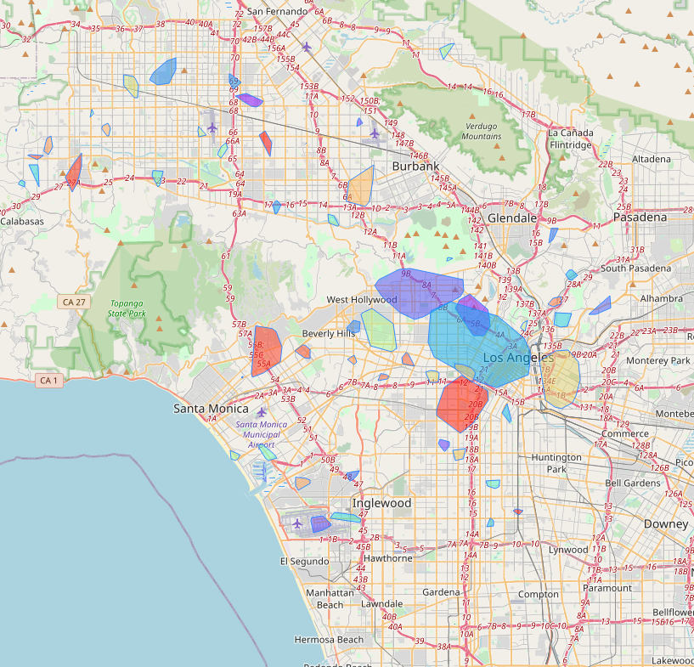


Geospatial clustering calculation
Folium

Slide 44
Characterize geospatial clusters

Slide 45
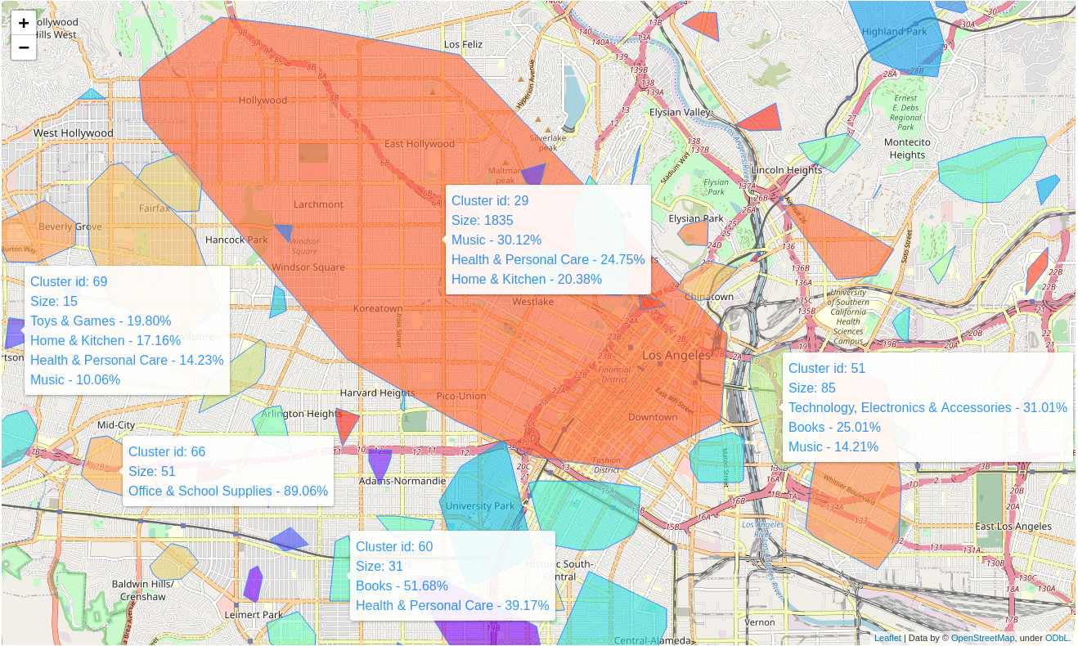
Geospatial clustering & prediction
Classified clusters in Los Angeles

Slide 46
7. Demo

Slide 47
8. Conclusions

Slide 48
Conclusions
Geospatial characterization based on text is possible.
Simple yet effective product document classifier.
Simple and easy-to-understand visualization.
Potential applications in other areas of the value chain:
Customer service characterization by geographic area.
Facility location problems.
Characterization of transport routes based on reports.
Notes:
Remover, usar solo slides de conclusiones

Slide 49
Conclusions
Potential applications in other domains:
Politics.
Psychology traits
Cultural characterization.
Other research paths:
Integrate other techniques
Complementary applications
Complementary contexts
Other ways to characterize geographic areas.

Slide 50
Thank you.
Any Questions?

Slide 51
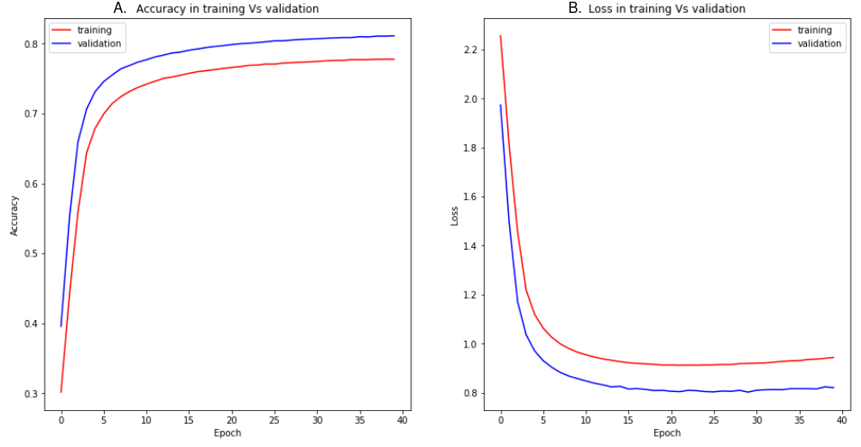
Product Document Embeddings
Hyperparameter tuning

Slide 52
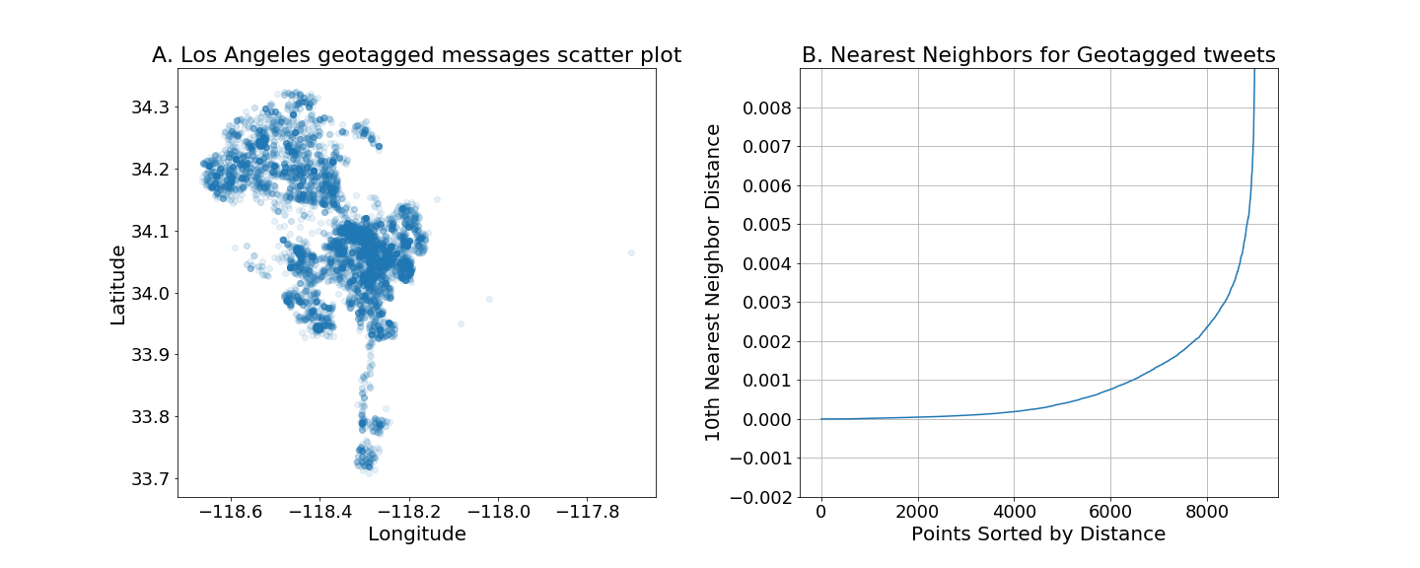
Geospatial clustering calculation
Obtain the best Ɛ epsilon by finding the point of inflection in ordered Nearest Neighbors, N. Rahmah and I. S. Sitanggang 2016

Slide 53
Limitations
The validation on the field was not feasible at the moment.
The data sets are not strongly related.
Twitter is not necessarily a place for product reviews
Amazon product reviews is no necessarily a place for random opinion
The data is outdated.
Notes:
Moverlas después de todo (backup), en caso de que pregunten

